Slide 1
Sentiment Analysis Of Twitter
Roll no.: 508
Name: Vishal Ramkumar Chaurasiya

Slide 2
Project Software Details
Sentiment Analysis Software analyzes text conversations and evaluates the tone, intent, and emotion behind each message and it uncovers more context from your text conversations and helps you to analyze the feedback.
Sentiment Analysis Software is a combination of several complex algorithms which are used for analyzing and identifying whether some set of incoming data contains any trends that can be identified and rated according to their strength and accuracy.

Slide 3
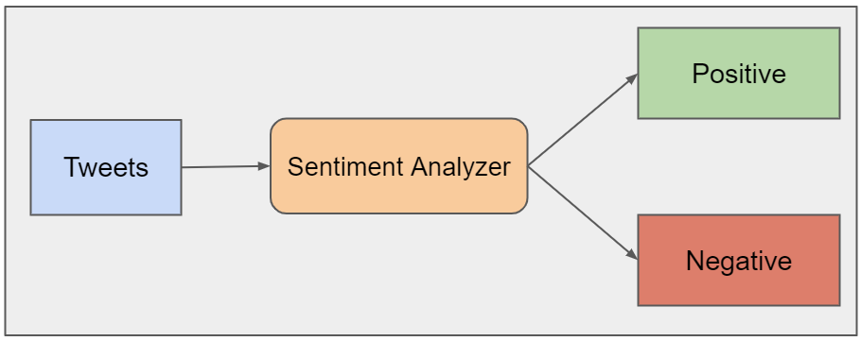
Architecture

Slide 4
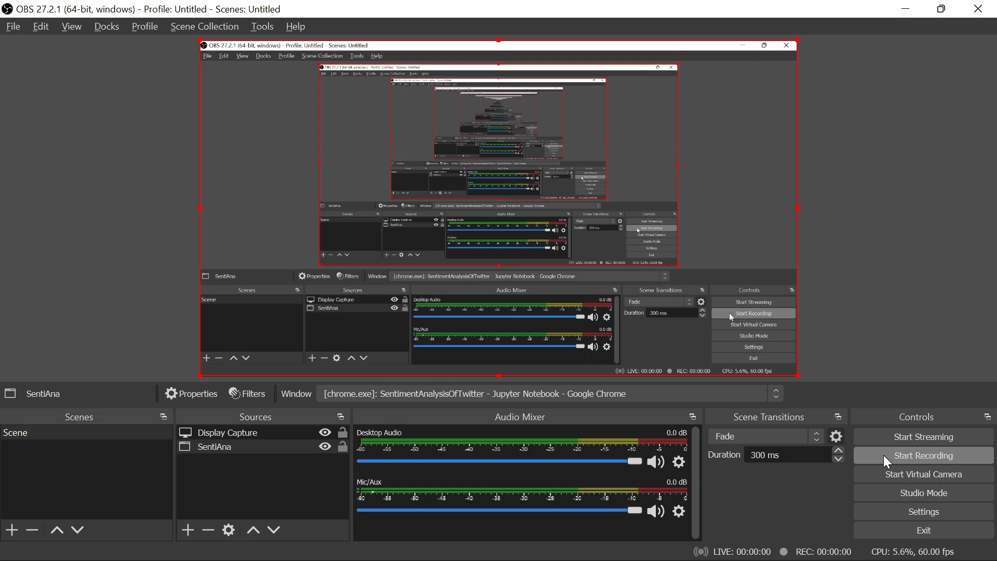
Explaination Video

Slide 5
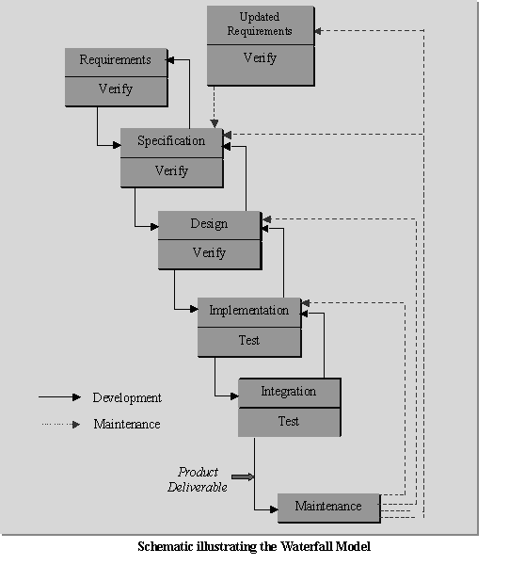
Software Process Model
Iterative Model:-
It is documentation driven, that is, documentation is produced at every stage.
Testing is inherent to every phase of the Iterative model.
It is an enforced disciplined approach.

Slide 6
Conclusion
Sentiment analysis or opinion mining is a field of study that analyzes people's sentiments, attitudes, or emotions towards certain entities.
Regardless of the name, the goal of sentiment analysis is the same: to know a user or audience opinion on a target object by analyzing a vast amount of text from various sources.
Sentiment Analysis helps to take right actions in future.

